Slide 1
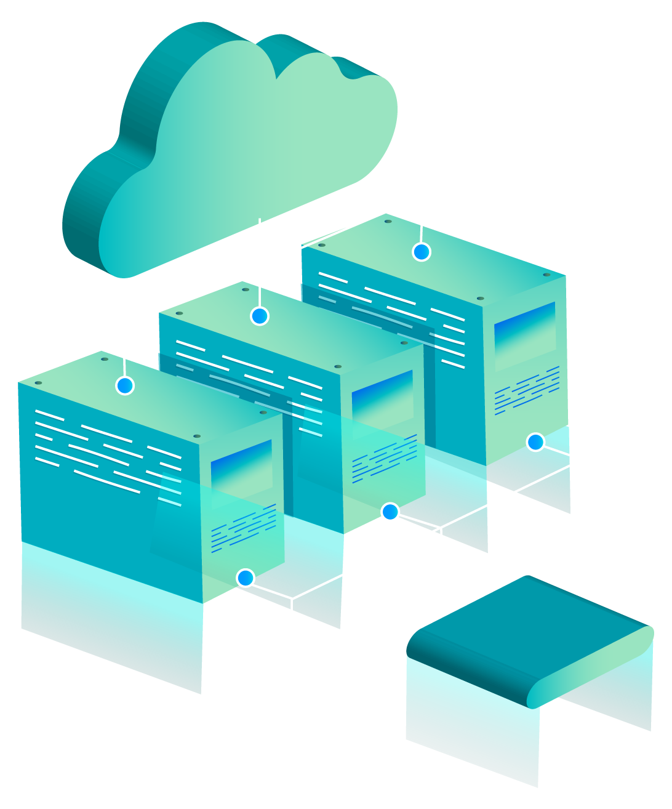
THE SERVERLESS ARCHITECTURE
Redefining the Future of Scalable Cloud Applications

Slide 2
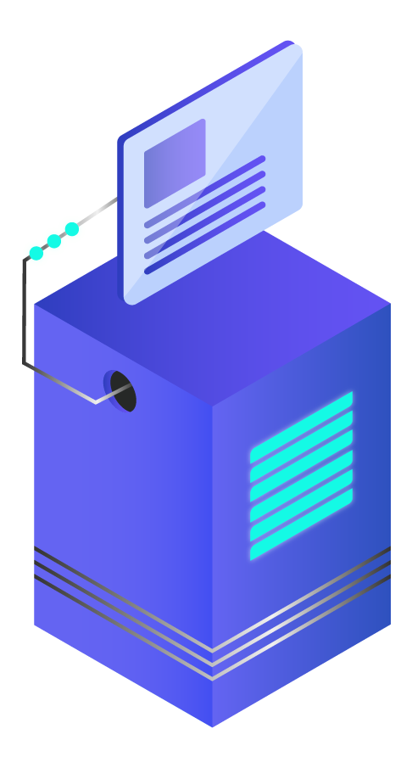
SERVERLESS COMPUTING?
Serverless computing is a model where cloud providers automatically manage infrastructure.

Slide 3
CHARACTERISTICS
Event-driven
01
02
Automatically scalable
Short-lived
03
04
Pay only for use

Slide 4
POPULAER SERVERLESS PLATFORM
AWS
Azure
GCP

Slide 5

BENEFITS?
Reduce Operational Overhead
Faster Development & Deployment
Cost Efficient
Automatically scales to demand
Developers can focus on business logic

Slide 6
LIMITATIONS?
Cold starts
Timeout limits
Monitoring & Debugging
Not suitable for all workloads

Slide 7

THANK YOU

